Slide 1

Software Engineering Department
Braude College of Engineering
Final Project – Phase A (61998)
Dynamic Labyrinths - Asymmetric Hunter vs. Builder
CODE: 26-1-D-22
By: Elio Pikuli Maxim Lazarenko
Advisor: PhD. Sulamy Moshe
Link to GitHub: https://github.com/ElioPikuli/Dynamic-Labyrinths---Asymmetric-Hunter-vs.-Builder.git

Slide 2
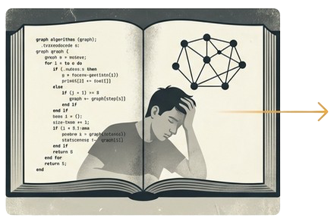
The Challenge: Learning Algorithms Can Be Abstract and Disconnected
Traditional methods often rely on "passive information transfer”.
This "one-size-fits-all" approach can fail to stimulate interest.
There is a significant need for interactive, student-centered tools.
Notes:
static diagrams and pseudocode that can lead to student disengagement.
, especially for students who struggle with abstract concepts.

Slide 3

The Evidence: Game-Based Learning Delivers Superior Outcomes
Recent empirical studies show that gamified environments can outperform traditional instructional methods.
Boeker et al. (2013)
A study in medical education found students using a game-based tool achieved significantly higher scores on cognitive knowledge tests and reported higher levels of fun and engagement.
Gudadappanavar et al. (2021)
Research in pharmacology revealed gamified sessions led to a marked improvement in post-test knowledge scores and created an active, "student-centered” environment.
Our Position: Our work is designed as a powerful, supplementary
enhancement to the existing curriculum.

Slide 4
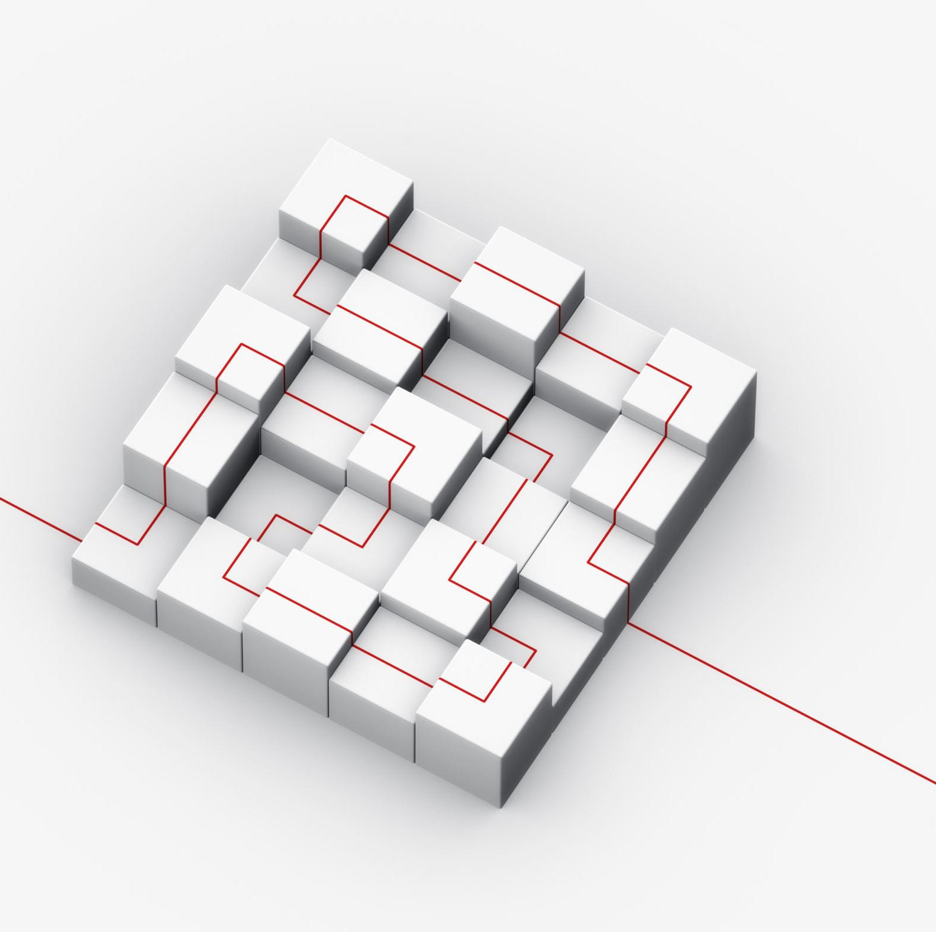
Our Solution: A Game to Make Algorithms Tangible
Project Definition Dynamic Labyrinths is an asymmetric multiplayer game designed to provide a unique and enjoyable approach to visualizing and learning pathfinding algorithms.
Central Idea
By immersing players in a competitive 3D environment where the map itself is variable, the game brings algorithmic logic to life. Players "feel" how map complexity impacts navigation.

Slide 5
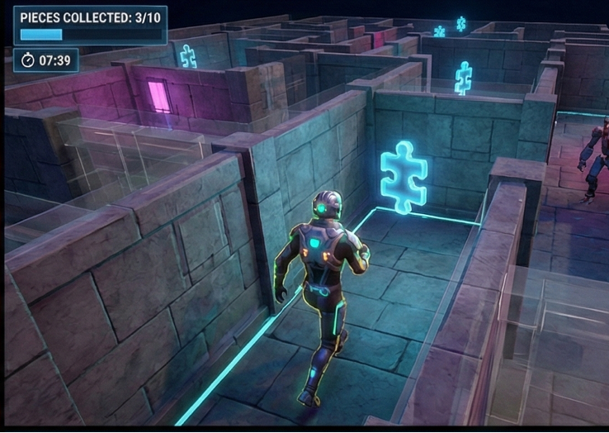
Two Roles, One Dynamic Battlefield
The Hunter
Objective: Navigate a complex 3D maze to collect puzzle pieces.
Challenge: Real-time navigation, obstacle avoidance, and making quick decisions to evade autonomous guard bots.

Slide 6
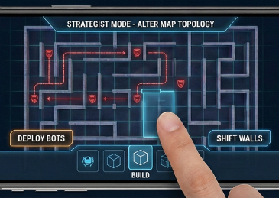
Outcome: A tense, constantly shifting landscape where strategy and adaptation are key.
The Builder
Objective: Dynamically alter the map's topology in real-time.
Challenge: Strategically place walls and obstacles to assist the guard bots and oppose the Collector.

Slide 7





The Educational Engine: A Post-Round Algorithmic Analysis
The project's key contribution is an educational feedback loop that connects gameplay directly to algorithmic theory.
1. Analyze
The system analyzes the final, unique map configuration.
2. Calculate
Calculates the optimal path via different algorithms.
4. Visualize
The system provides suggestions based on the optimal path.
3. Inform
Informing the player what is the optimal algorithm for this specific map.

Slide 8


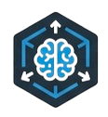
The Technology Powering the Experience
Unity Engine
The cross-platform
foundation for creating the
interactive 3D content,
using C# for implementing
complex game logic.
Cross-Platform Multiplayer
Built with Unity's Netcode for GameObjects (NGO) and Relay service to enable seamless connectivity between PC (Host) and mobile (Client).
Unity ML-Agents
An open-source toolkit used to transform the Unity environment in to a simulation for training intelligent agents via Reinforcement Learning.

Slide 9
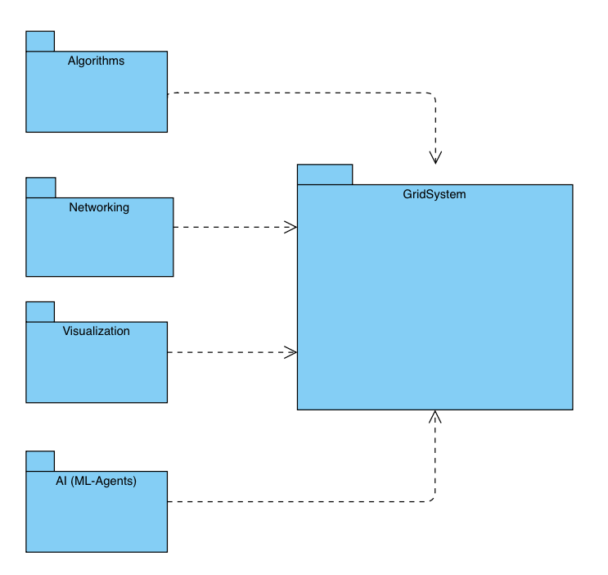
A Modular and Scalable System Architecture
Notes:
להוסיף הסברים לכל תיקיה

Slide 10
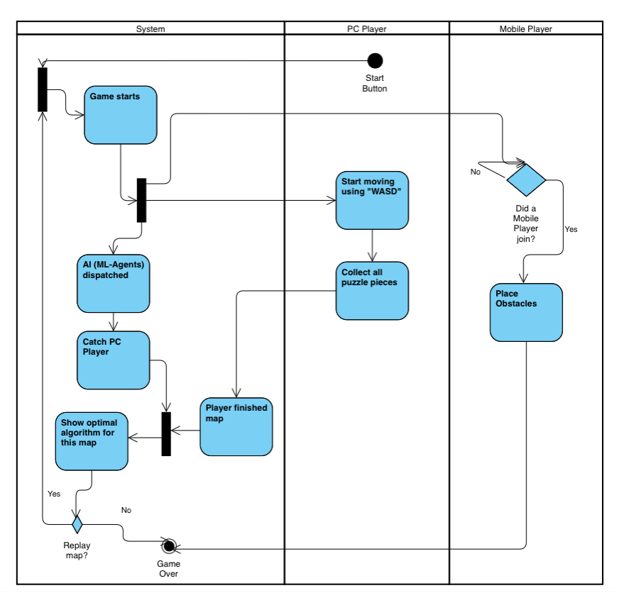
A Modular and Scalable System Architecture
Notes:
להוסיף הסברים לכל תיקיה

Slide 11
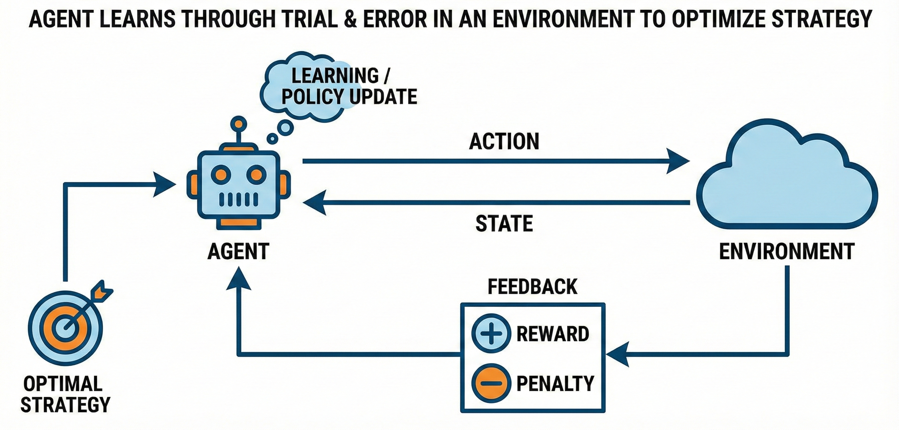
Training an Adaptive Opponent with Reinforcement Learning
Application in Dynamic Labyrinths
We generate an ML agent that acts as an autonomous guard bots.
This agent is trained to compete against the Hunter.
The result is a challenging opponent that can adapt its strategy.

Slide 12
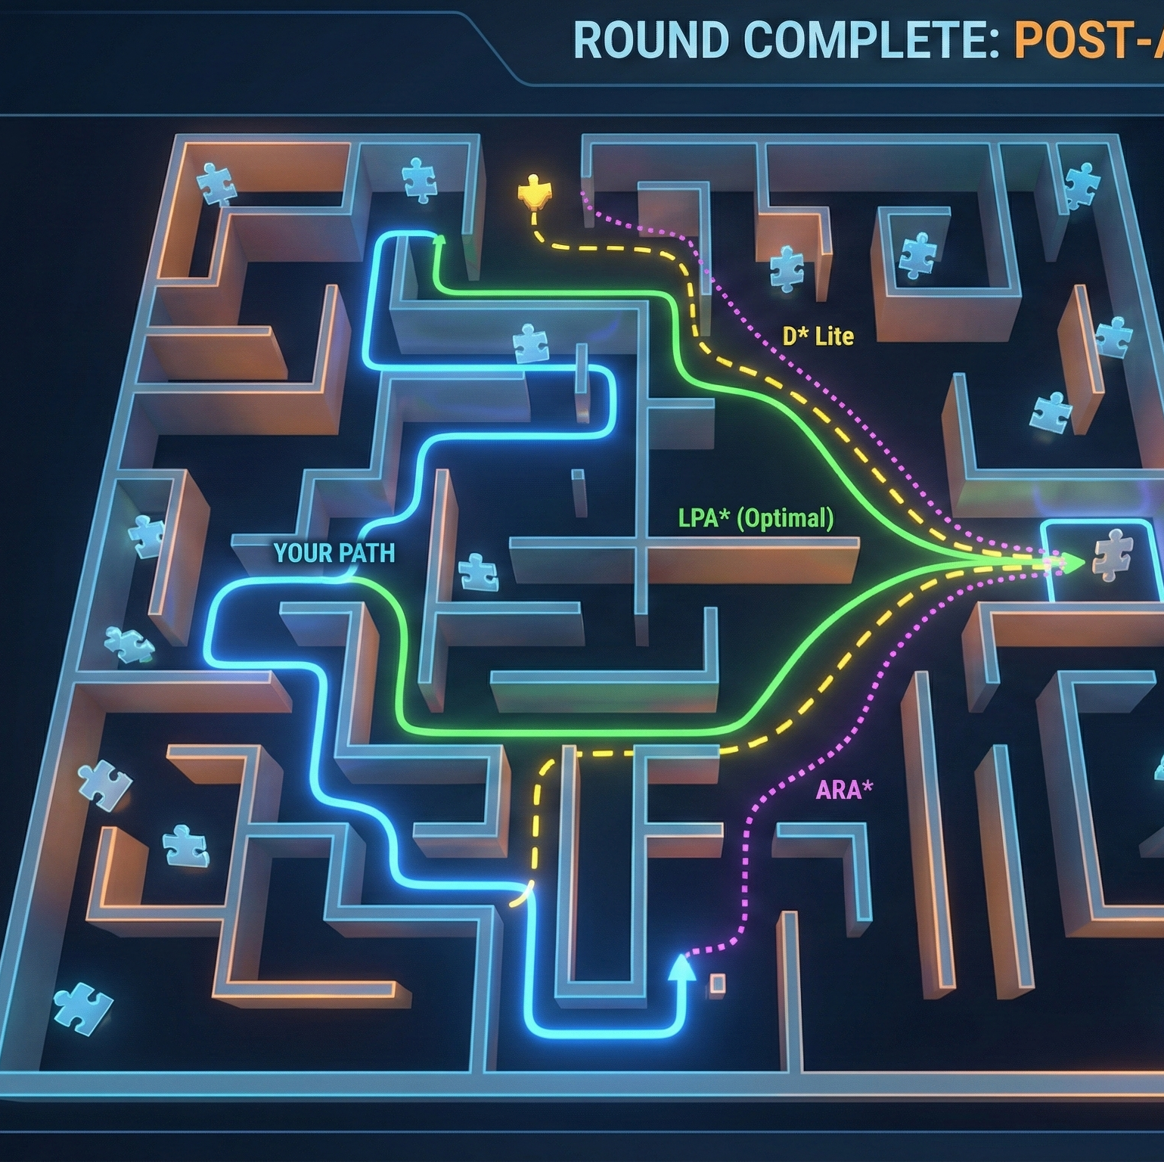
Pathfinding Algorithms
LPA*: Designed specifically for dynamic environments.
D* Lite: Optimized for navigation in unknown terrain.
ARA*: Balances calculation speed with solution perfection.

Slide 13

Defining Success: Core Functional Requirements
Visually render the step-by-step execution of algorithms.
Support cross-platform multiplayer.
Generate a competitive ML Agent.
Display educational information.
Allow the Builder to place obstacles.
Enable replayability of maps.
Show the best time of optimal algorithm.

Slide 14




Ensuring a Quality Experience: Non-Functional Goals
Performance & Compatibility
The game will be fully functional on Windows and Android.
Usability
The Ul will automatically adapt to different screen resolutions.
Reliability
Algorithmic integrity will be strictly kept.
Engagement
The game will be fun and successfully achieve its educational purpose.

Slide 15

Our Commitment to Quality: Verification and Evaluation
We utilize the industry-standard Unity Test Framework (UTF) for automated testing.
Evaluation Strategy
Algorithmic Integrity: Verifying the mathematical accuracy.
System Performance: Measuring network stability.
ML-Agent Proficiency: Assessing the Al agent’s behavior.
Educational Efficacy: Evaluating the design's effectiveness.

Slide 16
Verification Tools
EditMode Tests
Unit tests for algorithms, run instantly in the editor.
PlayMode Tests
Integration tests to verify game mechanics.
Performance Testing Extension
Benchmarking tools to measure execution.

Slide 17



Navigating Development: Key Challenges and Learnings
We intend to adopt an iterative “learn-by-doing” methodology, supplementing a foundational Unity course with extensive research into documentation and developer forums.
Optimization for Mobile Hardware
The computational expense of pathfinding required strict memory and resource management.
Cross-Platform Synchronization
Ensuring minimal latency and a consistent UI/UX on all platforms.
ML-Agent Training
We expect one of the primary challenges to be the training phase of the guard bots.

Slide 18

Impact: Where Intuition Meets Algorithmic Insight
Summary: Dynamic Labyrinths is a visualization tool that gamifies the differences between pathfinding algorithms.
The Core Value: It provides an intuitive understanding of how different algorithms work.
Final Takeaway: The project tries to bring abstract concepts into a real, memorable experience.

Slide 19
Thank You! Questions?

